Slide 1
Azure Devops

Slide 2
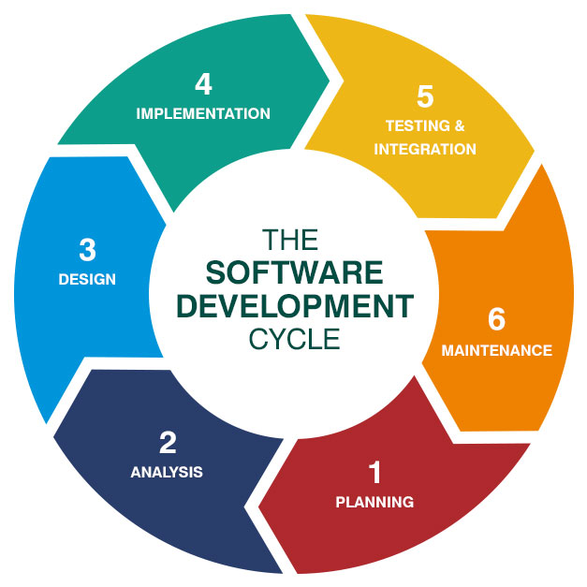
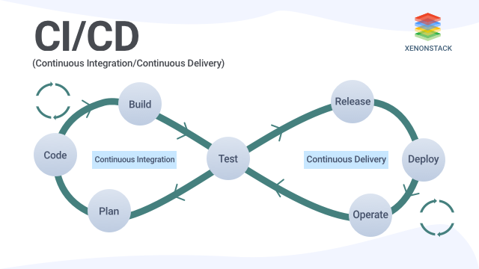
Devops as a SDLC

Slide 3
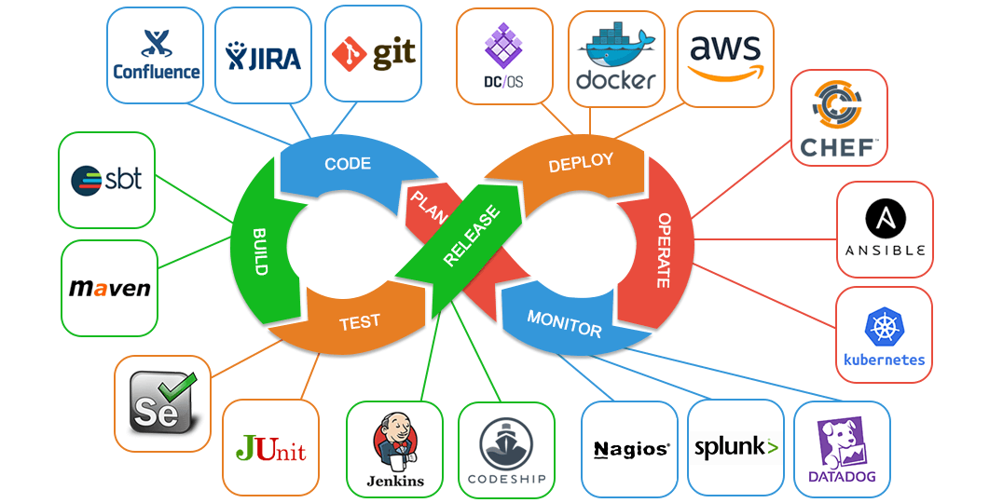
Open Source Tools for Devops

Slide 4
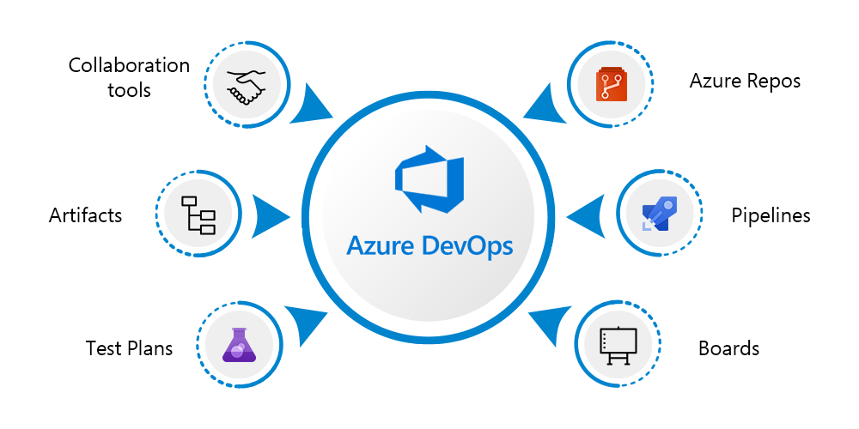
How come Azure Devops can be replaced with all these tools?

Slide 5
SDLC Models
Following are the most important and popular SDLC models followed in the industry :
Waterfall Model
Iterative Model
Spiral Model
V-Model
Big Bang Model

Slide 6
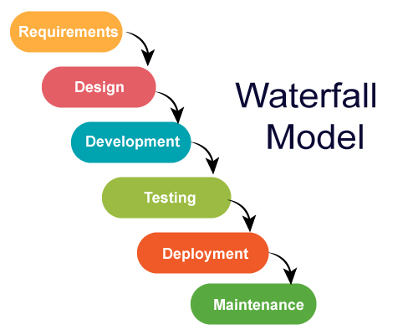
Water Fall Model

Slide 7
Water Fall Model
The major disadvantages of the Waterfall Model are as follows:
No working software is produced until late during the life cycle.
High amounts of risk and uncertainty.
Not a good model for complex and object-oriented projects.
Poor model for long and ongoing projects.
Not suitable for the projects where requirements are at a moderate to high risk of changing. So, risk and uncertainty is high with this process model.
It is difficult to measure progress within stages.
Cannot accommodate changing requirements.
Adjusting scope during the life cycle can end a project.
Integration is done as a "big-bang. at the very end, which doesn't allow identifying any technological or business bottleneck or challenges early.

Slide 8
Agile Manifesto
Individuals and interactions over processes and tools
Working software over comprehensive documentation
Customer collaboration over contract negotiation
Responding to change over following a plan

Slide 9
Agile Methods
Agile Methods:
Scrum
Crystal
Dynamic Software Development Method(DSDM)
Feature Driven Development(FDD)
Lean Software Development
eXtreme Programming(XP)

Slide 10
Scrum Methodology
SCRUM is an agile development process focused primarily on ways to manage tasks in team-based development conditions.
There are three roles in it, and their responsibilities are:
Scrum Master: The scrum can set up the master team, arrange the meeting and remove obstacles for the process
Product owner: The product owner makes the product backlog, prioritizes the delay and is responsible for the distribution of functionality on each repetition.
Scrum Team: The team manages its work and organizes the work to complete the sprint or cycle.

Slide 11
Devops Principles
Collaboration
Automation
Continuous Improvement
Customer-centric action
Create with the end in mind

